Slide 1
Domain driven design, year one
Perspectives of someone already down the path of implementing ddd

Slide 2
About me
Notes:
Introduce Yourself
Describe Apps Team

Slide 3
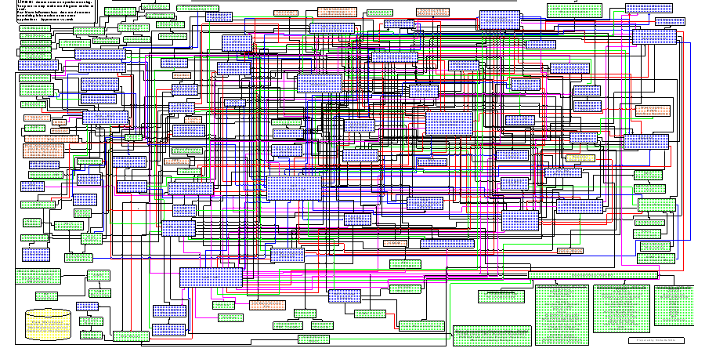
Problems in modern software
Notes:
Working with software that have many dependencies
Personal experience
Symptoms:
Spooky action at a distance bugs
Long Regressions
Fragile automated tests
Yak shaving
Two common causes for this

Slide 4
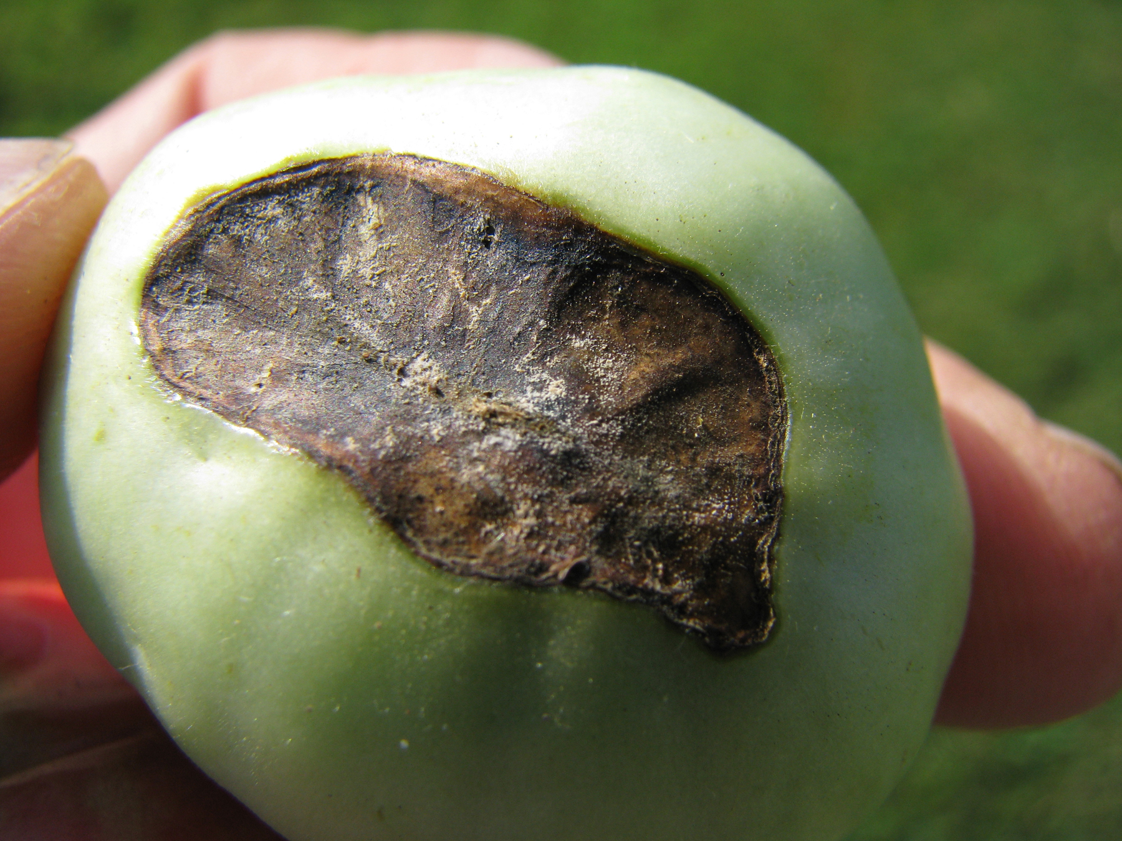
Software rot: how software dies a slow death
Notes:
First software rot
Accumulate tech debt through enhancements and hacks
Happens even with good architectural and design practices
Described by the CRAP cycle

Slide 5
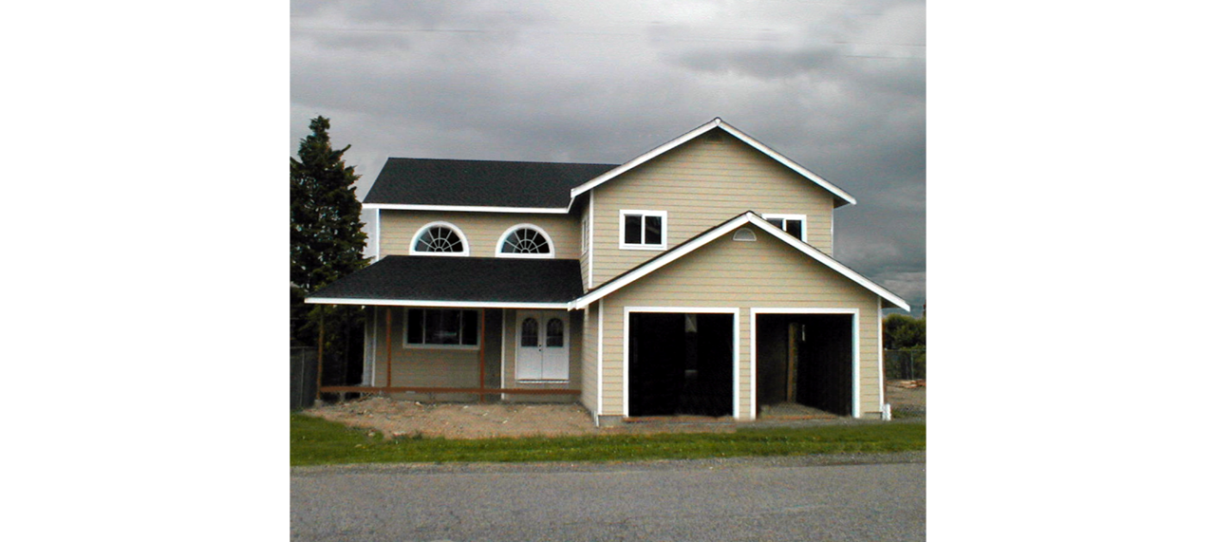
Crap cycle: Create
Notes:
Article in Visual Studio magazine from 2015: https://visualstudiomagazine.com/articles/2015/07/01/domain-driven-design.aspx
Zen for developers
Greenfield project
Development moves fast
New architecture is laid down
Research is done

Slide 6
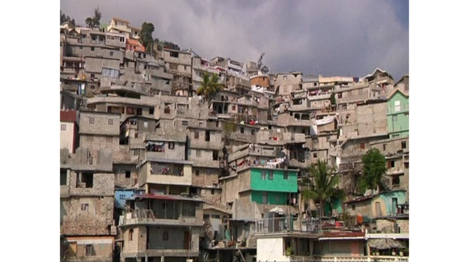
Crap cycle: repair
Notes:
Software matures, features and modules added.
Hacks for bugs
Other developers work on it

Slide 7
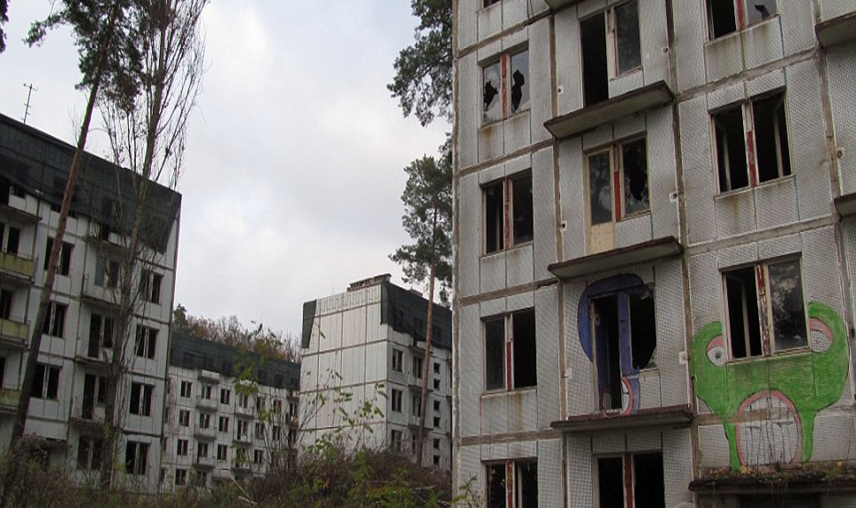
Crap cycle: abandonment
Notes:
Software is now bloated
Features stack up
Hacks litter the code
Developers stay away

Slide 8
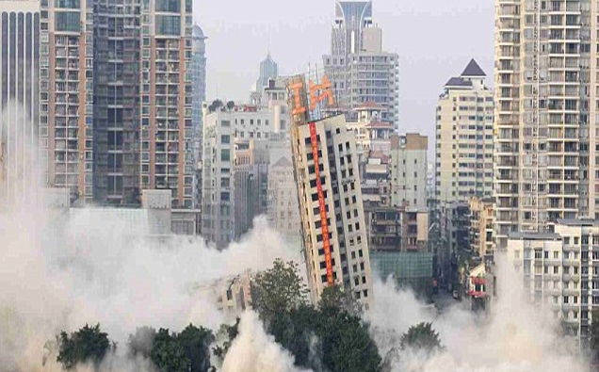
Crap cycle: replace
Notes:
Replacement talk
One team works on new version
Other team maintains
Grand rewrite and feature parody

Slide 9
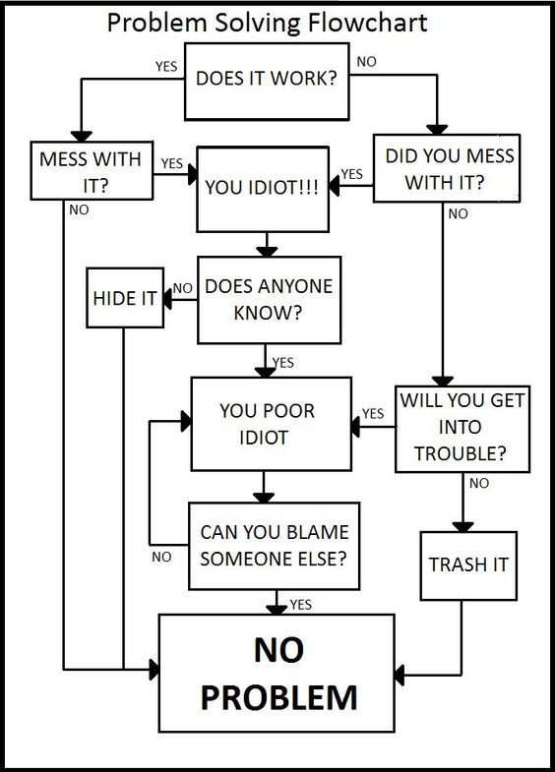
Geonetric’s legacy software
Notes:
Geonetric’s Legacy Software:
10 years old
Built on web forms
Architected with care…for the most part
190+ different projects
Long Regressions, up to two months
Large infrastructure built around releasing
Large amounts of tech debt
Still uses Octopus v1
Still uses CCNet
Why, everyone is afraid to touch it?
Want to replace but not Grand Rewrite

Slide 10

Software Intention: What is the meaning of software?
Notes:
Software unable to convey intention
Results in low adoption
High training cost
Super developers create a bus factor

Slide 11
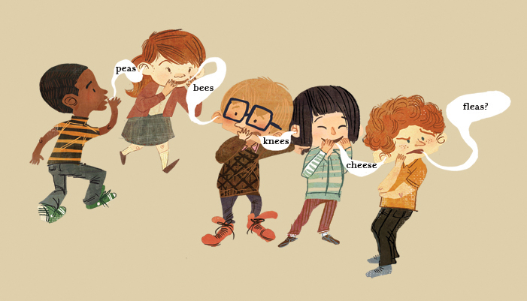
Lost in translation
Notes:
How does this happen? One of two ways:
Layers of communication results in developers getting unclear requirements
Developers add features that don’t exist by being clever
Example #1: Describe Project Pheonix/Wait Time
Example #2: Absentee PO saga:
5 years ago all communication flowed through PO
PO was always busy
Feedback didn’t always listen to the market
One module has 1000s of different settings
2014 low team morale
Lost half of team
PO was functional PO
- Read the Blue and Red Book
Based on the reading a different direction was needed

Slide 12
Goals of this talk
Show how Domain Driven Design will solve these problems while
providing an implementation guide from the perspective of an organization a year in to DDD.
Notes:
Read the goals

Slide 13
What is domain driven design?
DDD is “primarily about modeling a Ubiquitous Language in an explicitly Bounded Context”
(From Domain Driven Design Distilled, Vernon 2016)
Notes:
Domain Driven Design – Business Driven Design, designing based on the needs of the business
Domain is the Problem Space the business inhabits
Two sets of patterns
Strategic Design
Tactical Design
Talk will be mostly about Strategic Design

Slide 14
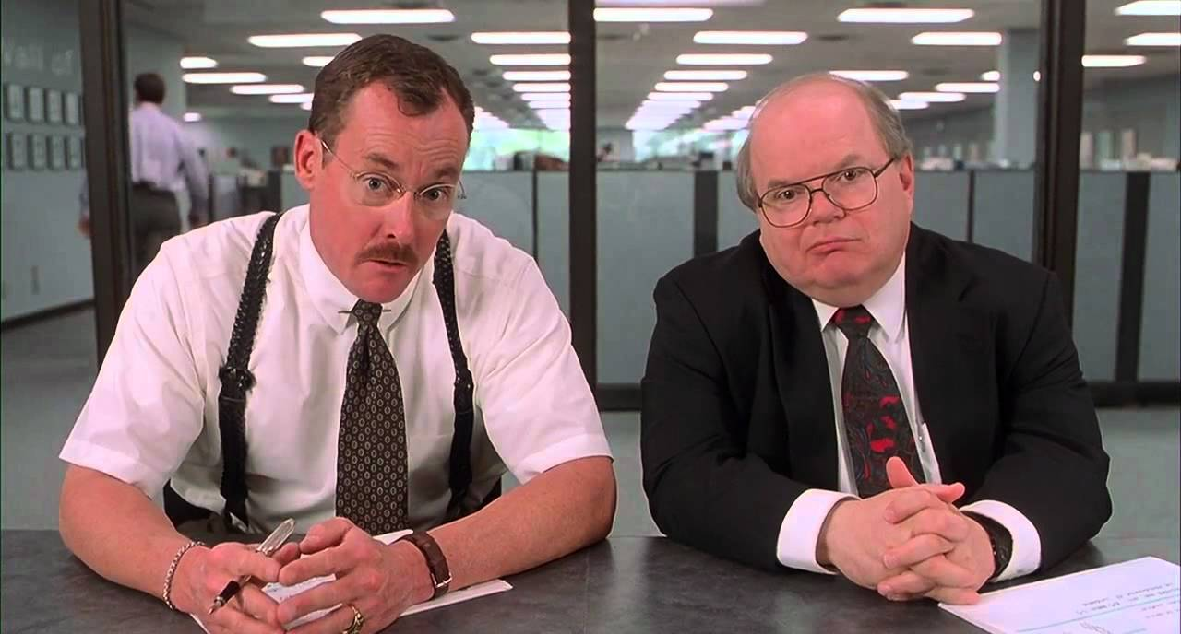
Step #1 – Domain mapping What would you say you actually do here?
Notes:
First undertake an exercise on what the company did

Slide 15
Identify the domain experts
A subject-matter expert (SME) or domain expert is a person who is an authority in a particular area or topic. The term domain expert is frequently used in expert systems software development, and there the term always refers to the domain other than the software domain. – Wikipedia (https://en.wikipedia.org/wiki/Subject-matter_expert)
Notes:
Define Domain Expert
Expert on a certain topic
Get direct feedback from them

Slide 16

Learning about the business with domain mapping
Find some very knowledgeable Domain Experts
Sit down in a room for about an hour with a white board
List out all of the things that is done, at a high level, to solve the problems of the organization
Notes:
Explain Domain Mapping objectives

Slide 17
Domain mapping cont’d
Group them together into common themes, these are called Subdomains
Now list out how each Subdomain’s problem is solved with each Software Solution
Notes:
Define Subdomains

Slide 18
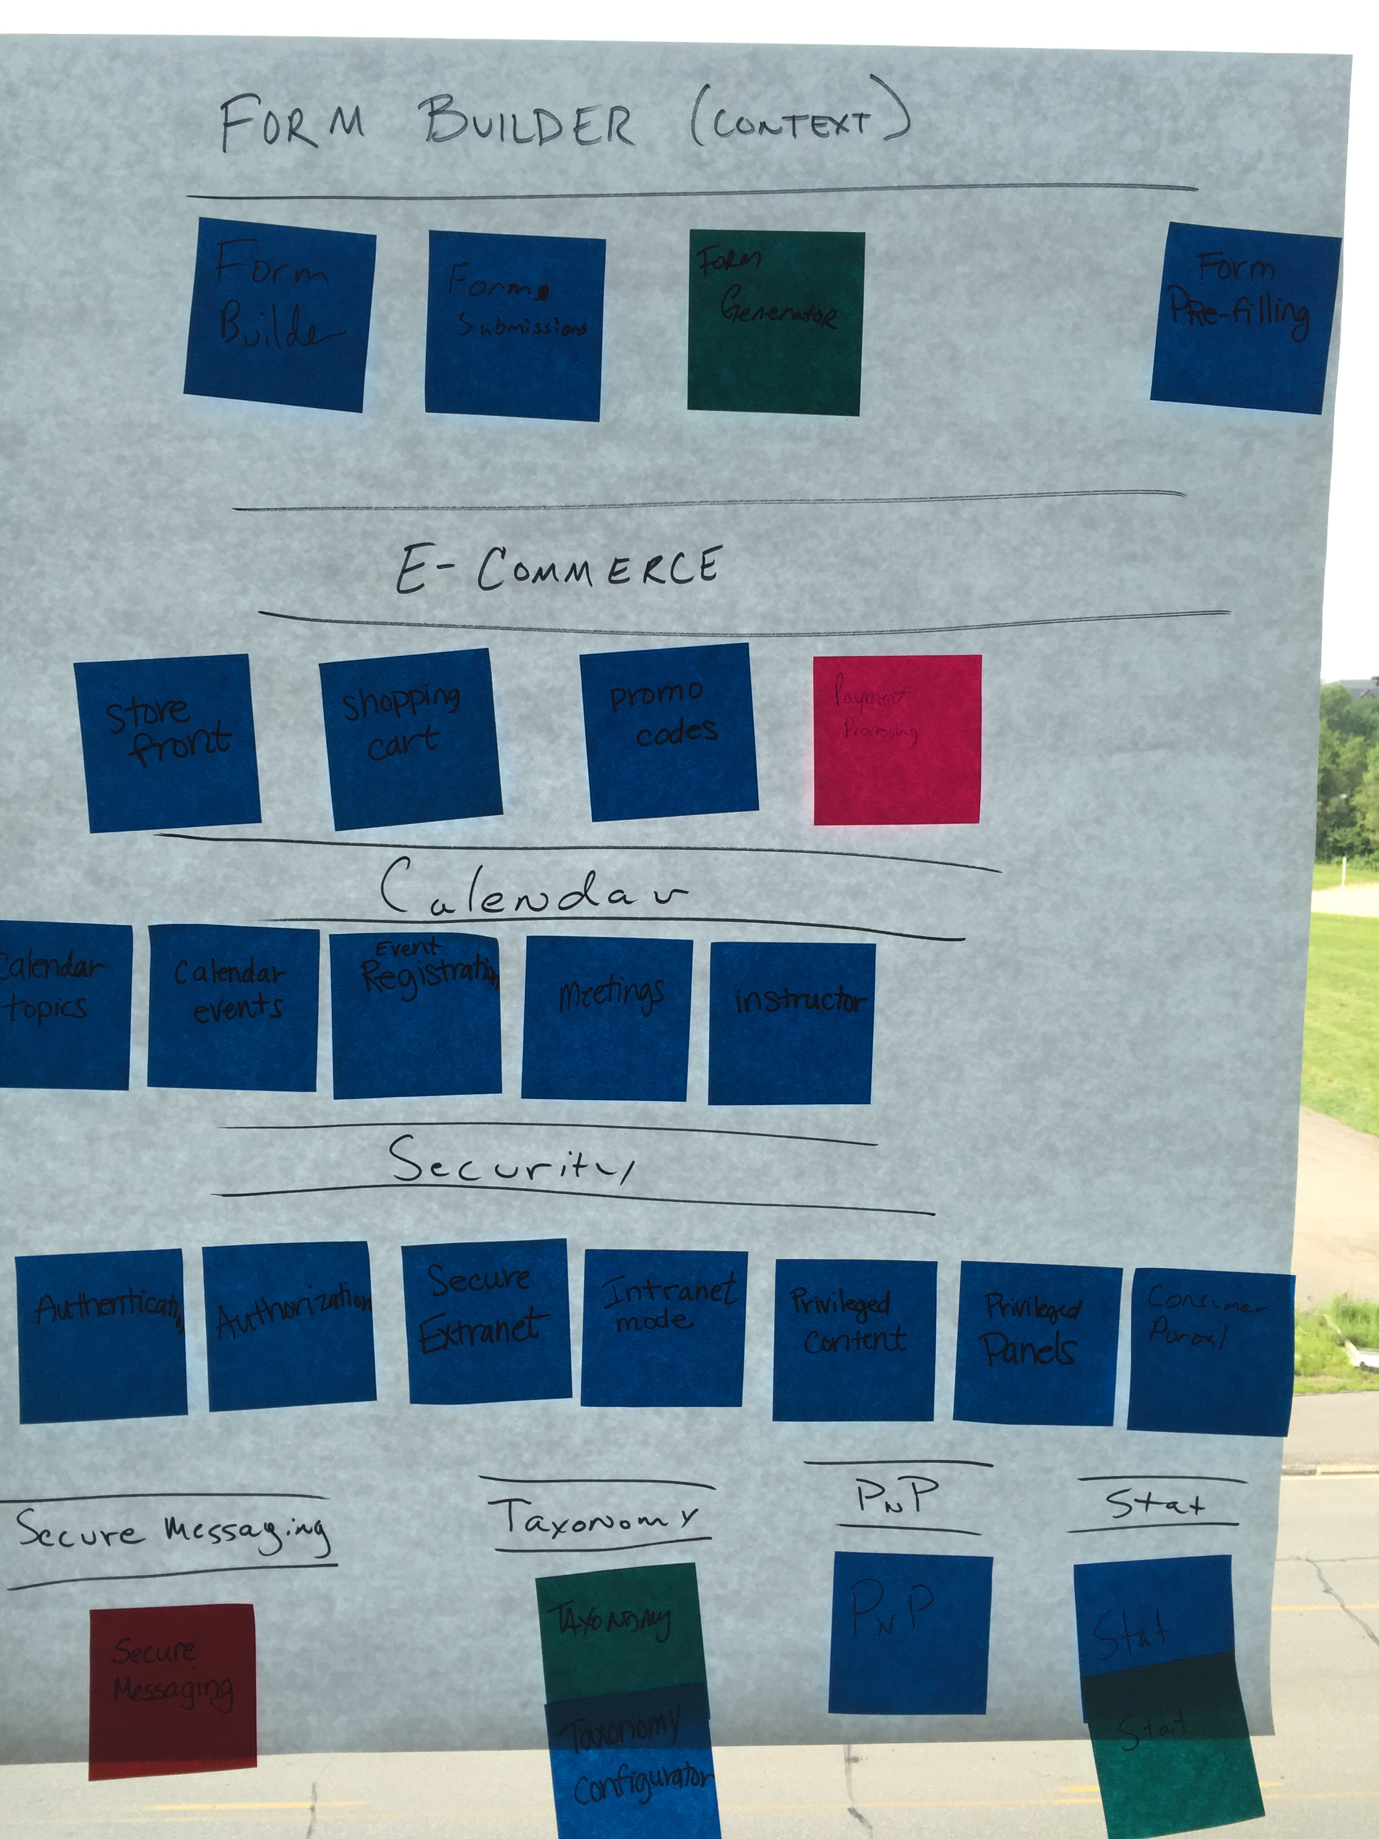
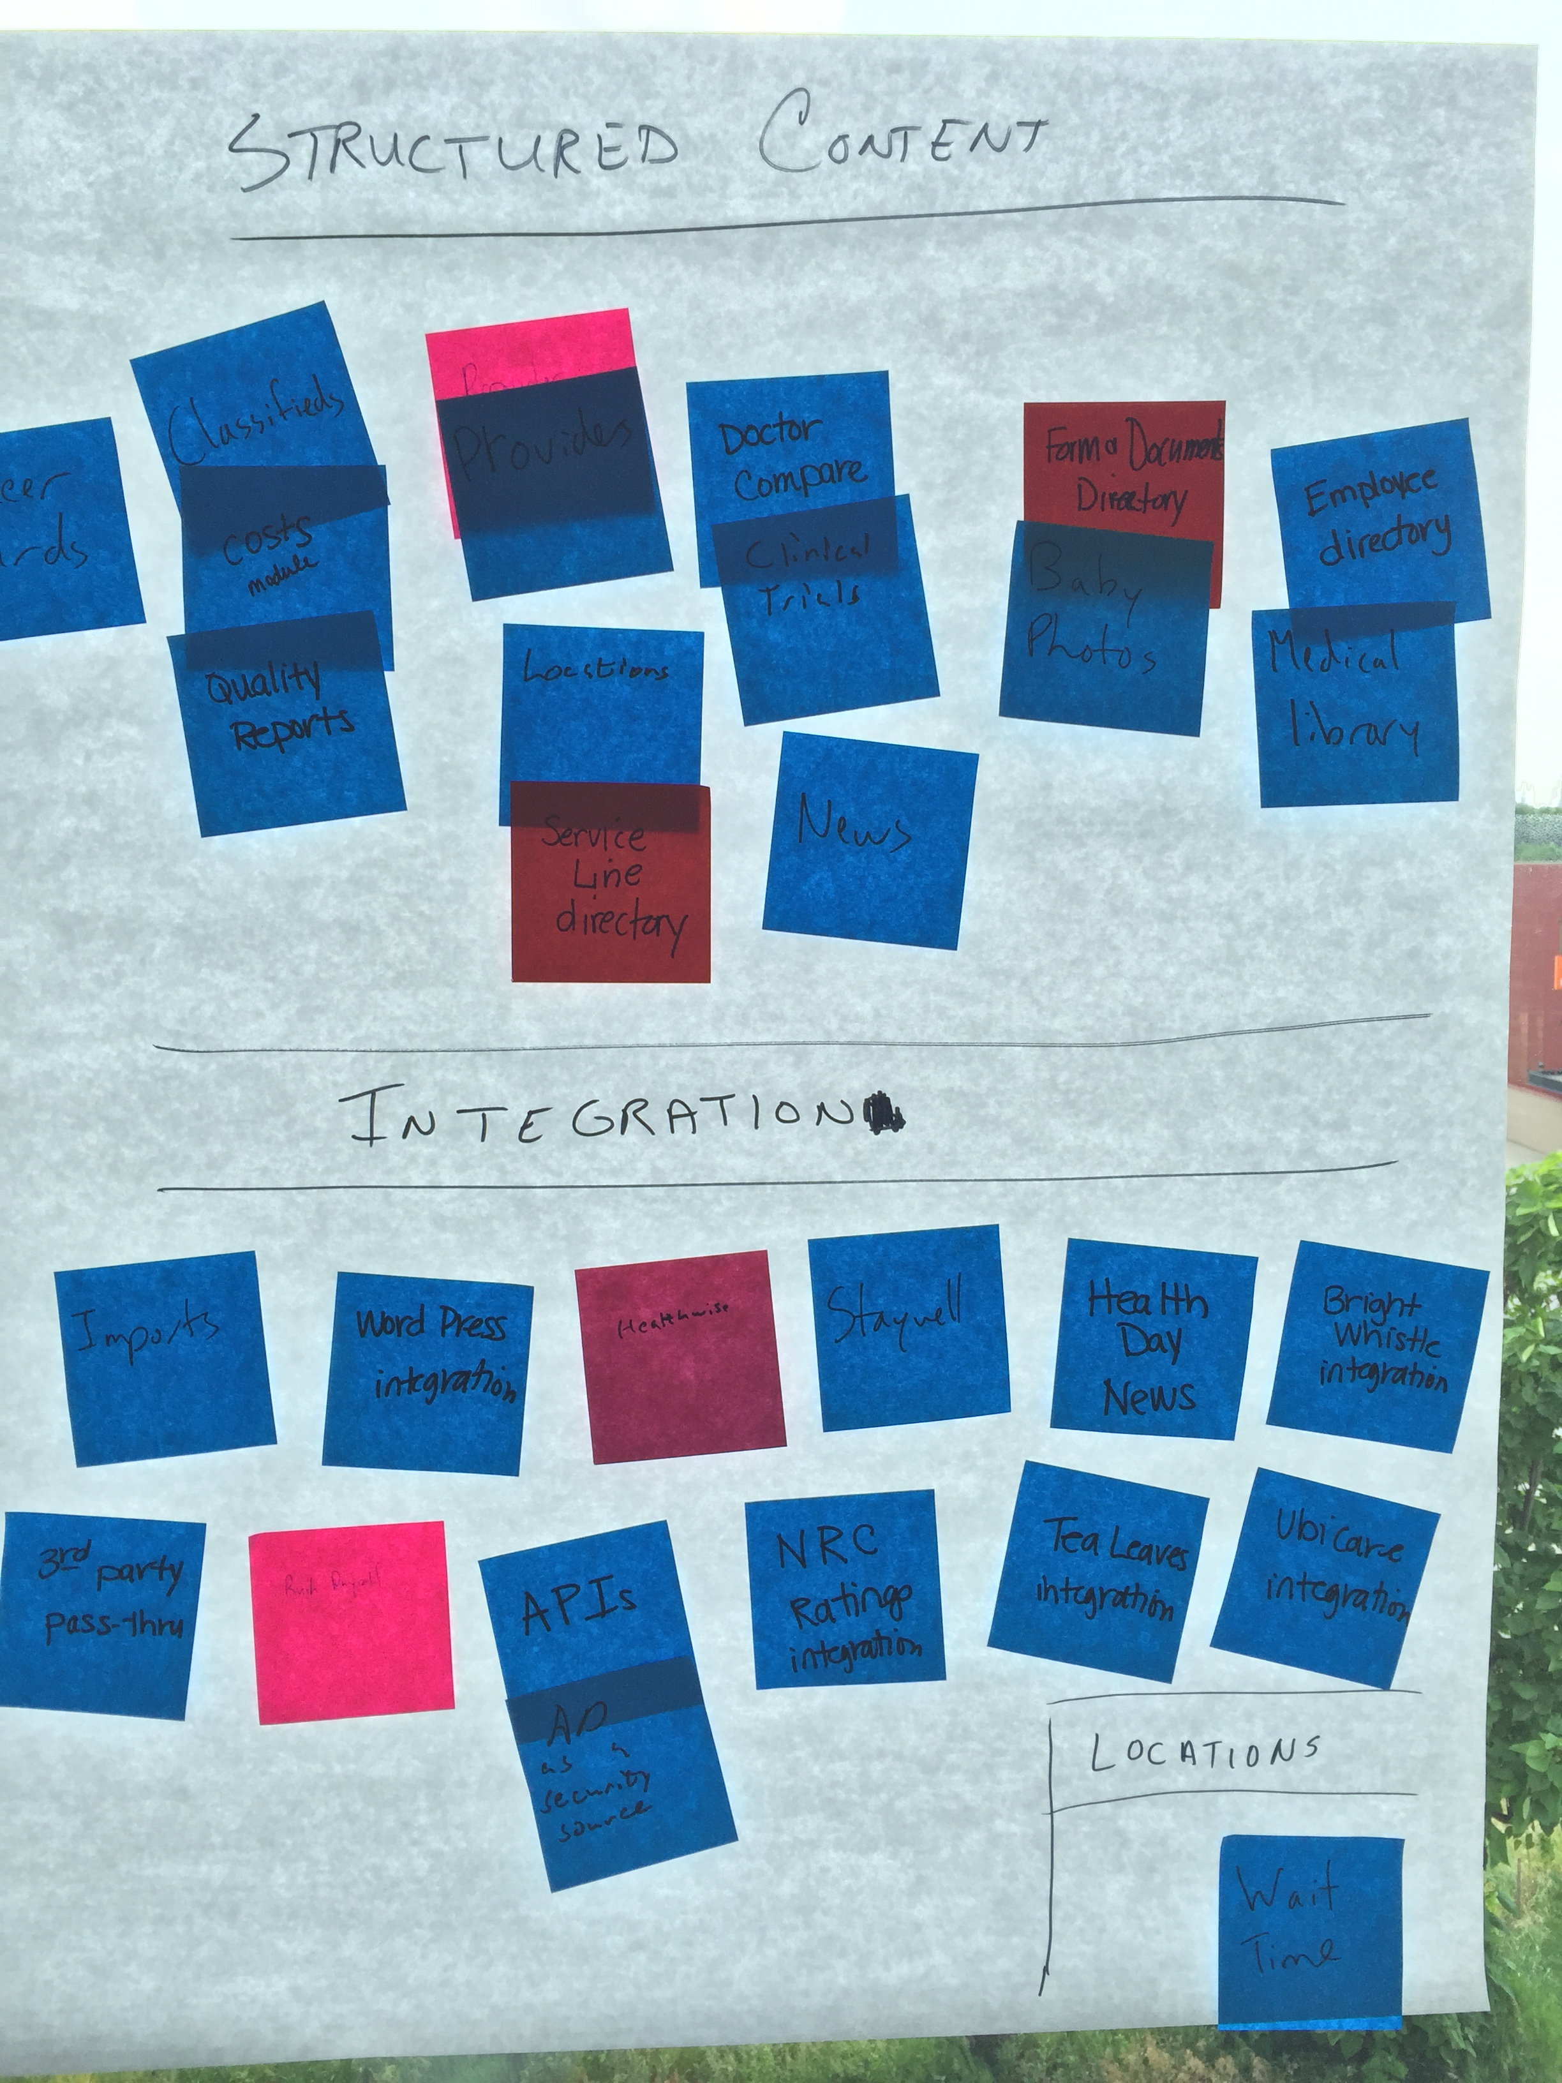
Domain mapping in picture form
Notes:
Sat down with Organizational Product Owner
1.5 hour meeting
Listed all things organization
Grouped sticky notes together into common Subdomains
List solution to Subdomains

Slide 19

Step #2 – Ubiquitous language solving a problem via shared language
Notes:
Started with a new product
Goal was to experiment with DDD
New Architecture
New way of interacting
New way of thinking
New Product Owner focus

Slide 20


the next big idea
Start the DDD process with the next big initiative that brings significant value to the organization
Do not implement
As a refactoring
With a minor feature enhancement
With a major feature enhancement
Notes:
Initiative should:
Bring a lot of value
Be moderately complex
Or eventually be moderately complex
Heavily utilized
Red book details criteria
Short version, don’t use Tactical Patterns with
Crud apps
Low value apps
Low volume apps
Describe why Form Builder was chosen
Describe Form Builder
New system would be built on DDD architecture
Allow clients to build their own forms

Slide 21

Cutting out the red tape
Identify Domain Experts at the start of the project
Organize regular meetings directly with developers
Be creative with getting feedback
Notes:
Two types of client interaction
GAG
CAG
Would meet regularly
- What to do when Domain Experts don’t have time

Slide 22

Solving the problem
Work directly with Domain Experts to solve the problems
Develop concepts including:
Actors
Processes
Artifacts
Events
Notes:
Domain Experts helped capture process of
Building forms
Publishing forms
Responses are captures
Responses are accessed
PHI logging involved
Views needed

Slide 23
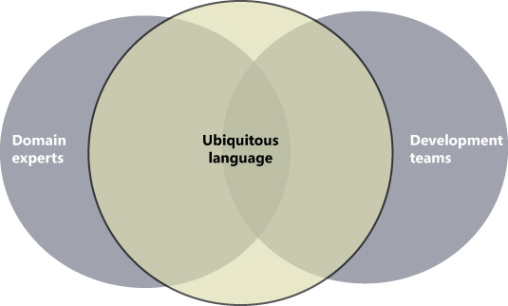
Ubiquitous language – The language of the business
Built after the process is defined
Common shared language
Captures all language, not just nouns
Use with BDD and/or ATDD
Becomes the language of the organization
Notes:
Define Ubiquitous Language

Slide 24
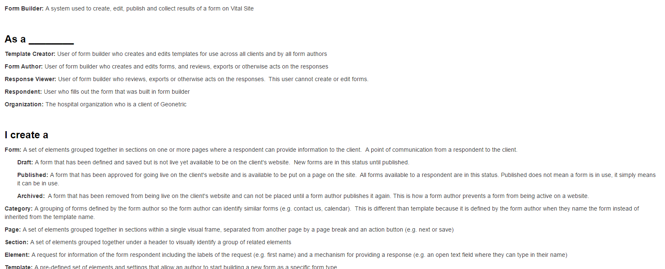
Form Builder glossary
Notes:
Form Builder’s Glossary Captured – Initial cut at Ubiquitous Language
Built in glossary form
Product Owner initially wrote
Includes
Actors
Forms
Process Flow of a Form (see the status)
Parts of a Form
Response Workflow
Publically accessible for all to see, confluence

Slide 25
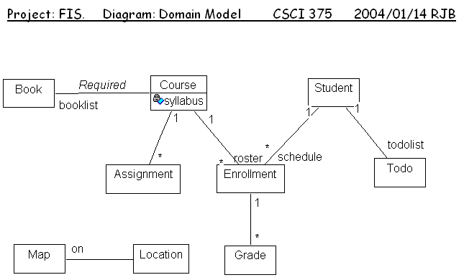
Language to Code – the domain model
Notes:
Domain Model
Most important part of any DDD application
Ubiquitous Language in Software Form
Kept isolated from other parts of the app
Goal is to have a robust domain model with all of the business logic
Otherwise the model suffers from anemia, known as an Anemic Model

Slide 26
Language Becoming Code example
Car – A four wheel vehicle made for residential driving
Driver – Operator of the car
Drive – The act of controlling the car while in motion
Miles – The distance the car travelled
Tires – Rubber wheel that makes contact with the ground
public class Car {
public void Drive(Driver driver, int miles) {
// Apply mileage
if (Tires[0].CurrentMileage > Tires[0].AllowedMileage) {
EventPublisher.Fire(new TireExpiredEvent(this));
}
}
}
Notes:
Car simulator example glossary.
In this case the Form Builder glossary resulted in code that wrote itself
So important to have a good Ubiquitous Language as it results in code that writes itself with combined with tactical patterns

Slide 27
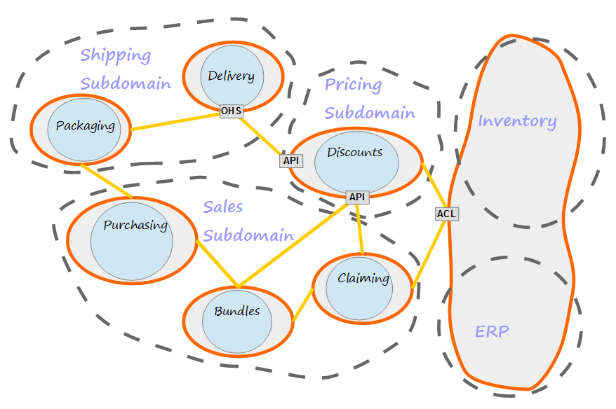
Step #3 – Bounded contexts drawing out the solution
Notes:
Domain Model has been defined initially
Time to:
Distill it by vetting the language
What solutions will be needed

Slide 28
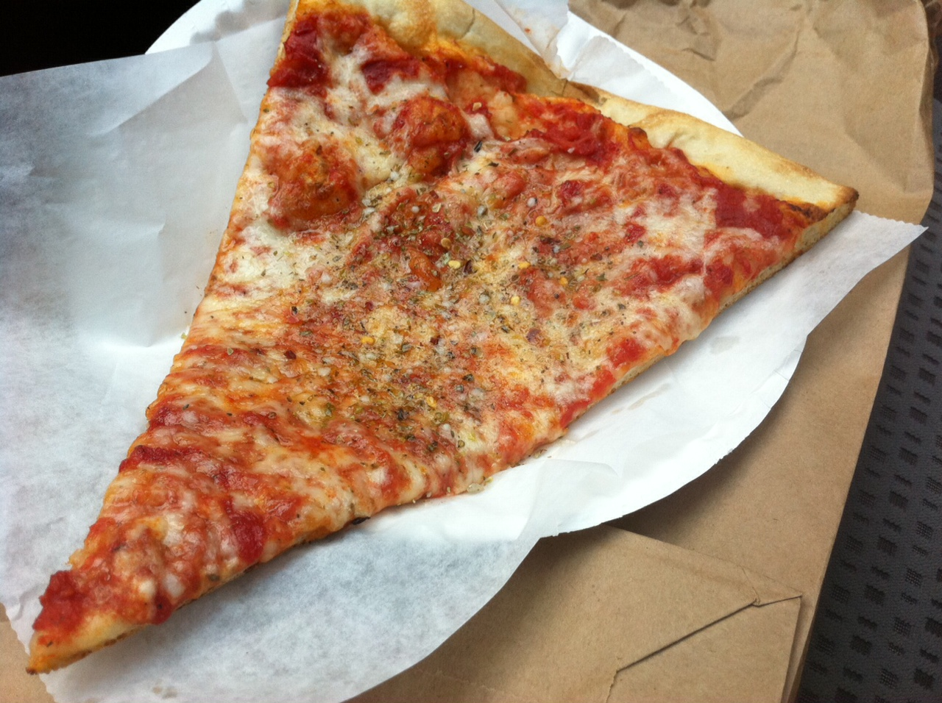
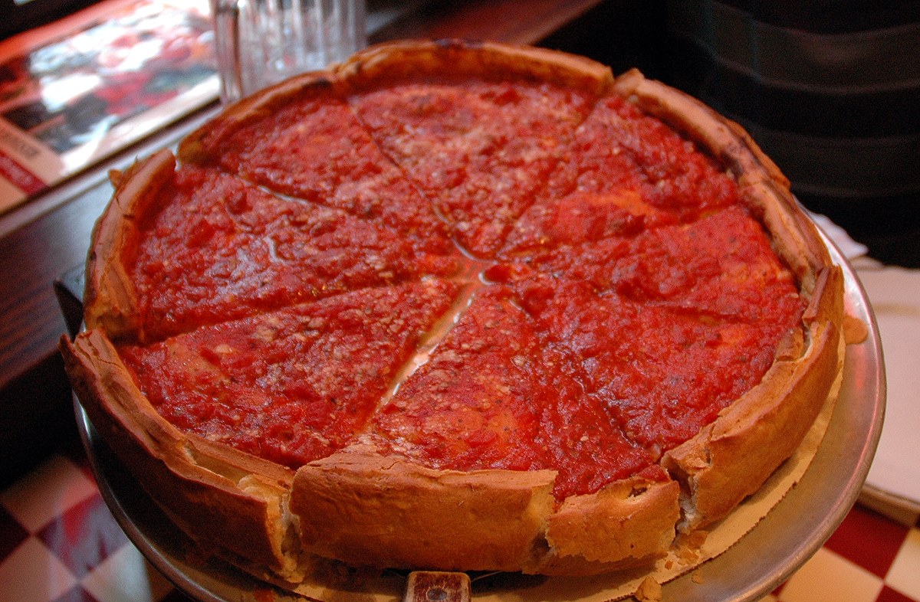
The limits of language
Pizza: Chicago
Pizza: New York
Notes:
Meanings depend on perspective
In the legacy system a couple of examples
Three different ways to say provider
Doctor: Code
Physician: Old documentation
Provider: Organizational Term
Locations – Three different types
Clinical Trial Location
Hospital Event
Provider’s place of practice
Leads to a type that captures all concepts across all three
Locations is littered through out the code
No such thing as an Organization wide language

Slide 29
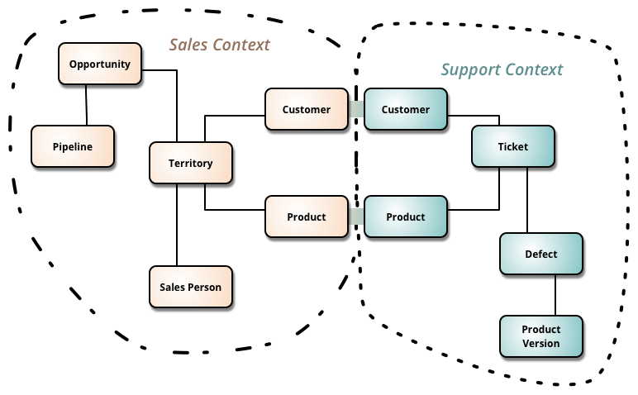
Bounded contexts: linguistic boundaries around ubiquitous language
Represents the Ubiquitous Language in Software Form via the Domain Model
Look for concepts that have different meanings to different people
Customer: Person who writes the checks to pay for our services
Customer: Person who called in with an issue
Foreign concepts go in other Bounded Contexts
Draw borders around common concepts, it is important to have one Bounded Context per Subdomain
Notes:
Define Bounded Context
All Bounded Contexts end with the word Context
Form Builder Context foreign concept example:
Users is not a concept in Form Builder
Instead we translated User to be Form Author, Response Viewer, etc…
Role based security
User can then exist on its own context
Same with Payments and VitalSite, Form Builder has no concept of a Doctor, Location, Credit Card #

Slide 30
Types of bounded contexts
Core Domain: The core of the initiative that brings in the most value. This will get the most attention and resources. This will be the focus of development.
Supporting Subdomain: A subdomain critical to the effort and still provides value. Usually will be developed in house.
Generic Subdomain: Domain that doesn’t provide much value but still ticks a box of some sort.
Supporting or Generic Subdomains may already exist prior to development.
Notes:
First define
Describe Form Builder ecosystem
Core Domain: Form Builder
Supporting Subdomain: VitalSite
Generic Subdomain: Payments and Security
VitalSite existed prior
Payments and Security did not
To Speed up time to market
Bought Security off the shelf
Payments would be pushed back
Payments will be off the shelf

Slide 31

Context Maps: Mapping the software terrain
Draw after Bounded Contexts defined
Visualizes the project
Relationships can be characterized into different types
Relationship types dictates how integration occurs
Notes:
Definition, read slide

Slide 32

Bounded Context Relationship: Partnership
Success depends on each other
Releases done in parallel
Maximum amount of collaboration
Notes:
Big initiative between internal teams releasing together

Slide 33
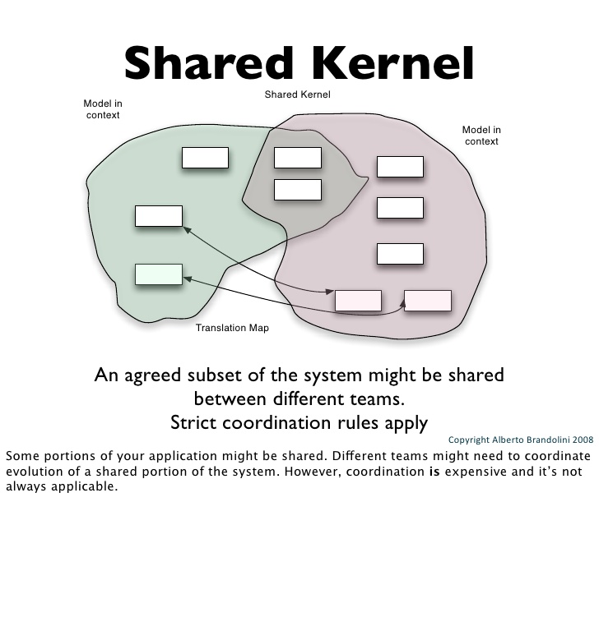
Bounded Context Relationship: Shared kernel
Shared part of the domain model
Rare occurrence
Strict coordination is needed
Notes:
Have never run into this situation

Slide 34
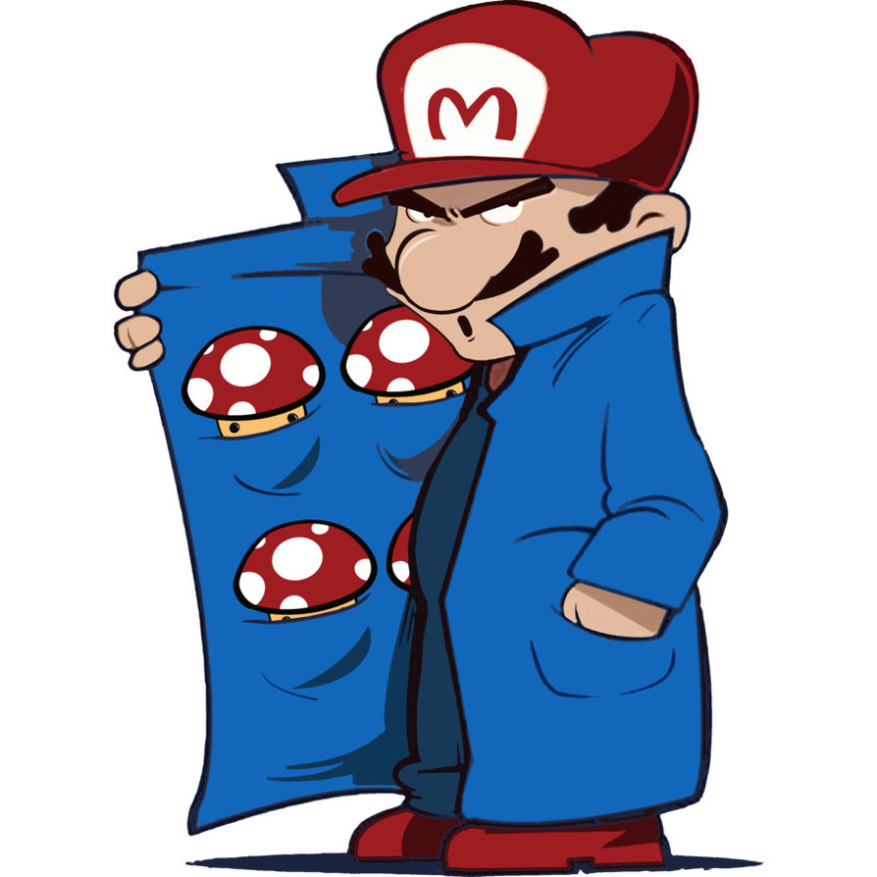
Bounded Context Relationship: Customer supplier
Upstream/downstream relationship
Downstream is the customer
Upstream is the supplier
Downstream is involved in planning as a Customer
Notes:
Most common interaction between internal development teams
Can sometimes happen with external software with custom apis

Slide 35

Bounded Context Relationship: conformist
Upstream Context is static
Upstream may be unaware of downstream integration
Downstream conforms to the upstream
Integrate usually with an Anti-Corruption layer
Notes:
- Usually involves apis from large corporations that are messy
- Conformists usually will not change for any integrating party

Slide 36
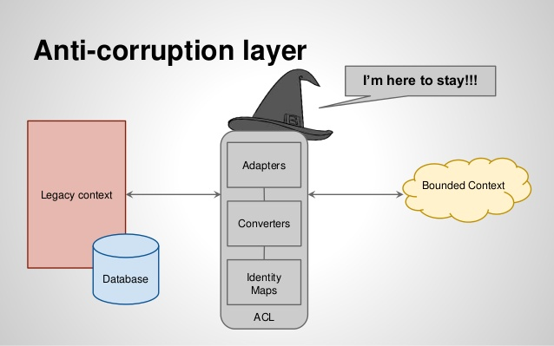
Bounded Context Relationship: Anti-corruption layer
Layer prevents model corruption
Involves an Adapter to translate foreign concepts
Notes:
- Describe Form Builder anti corruption layer with security

Slide 37
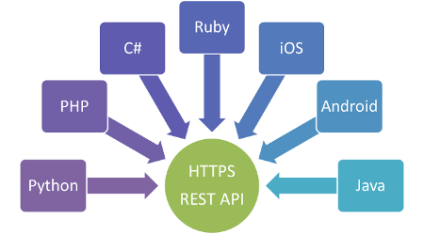
Bounded Context Relationship: Open host service
Open protocol which multiple systems can interact
Well documented and easy to use
Notes:
- This is usually an API of some sort

Slide 38
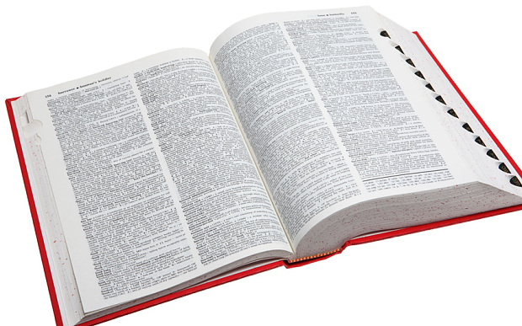
Bounded Context Relationship: Published language
Paired with an Open Host Service
Defines the bounded context

Slide 39
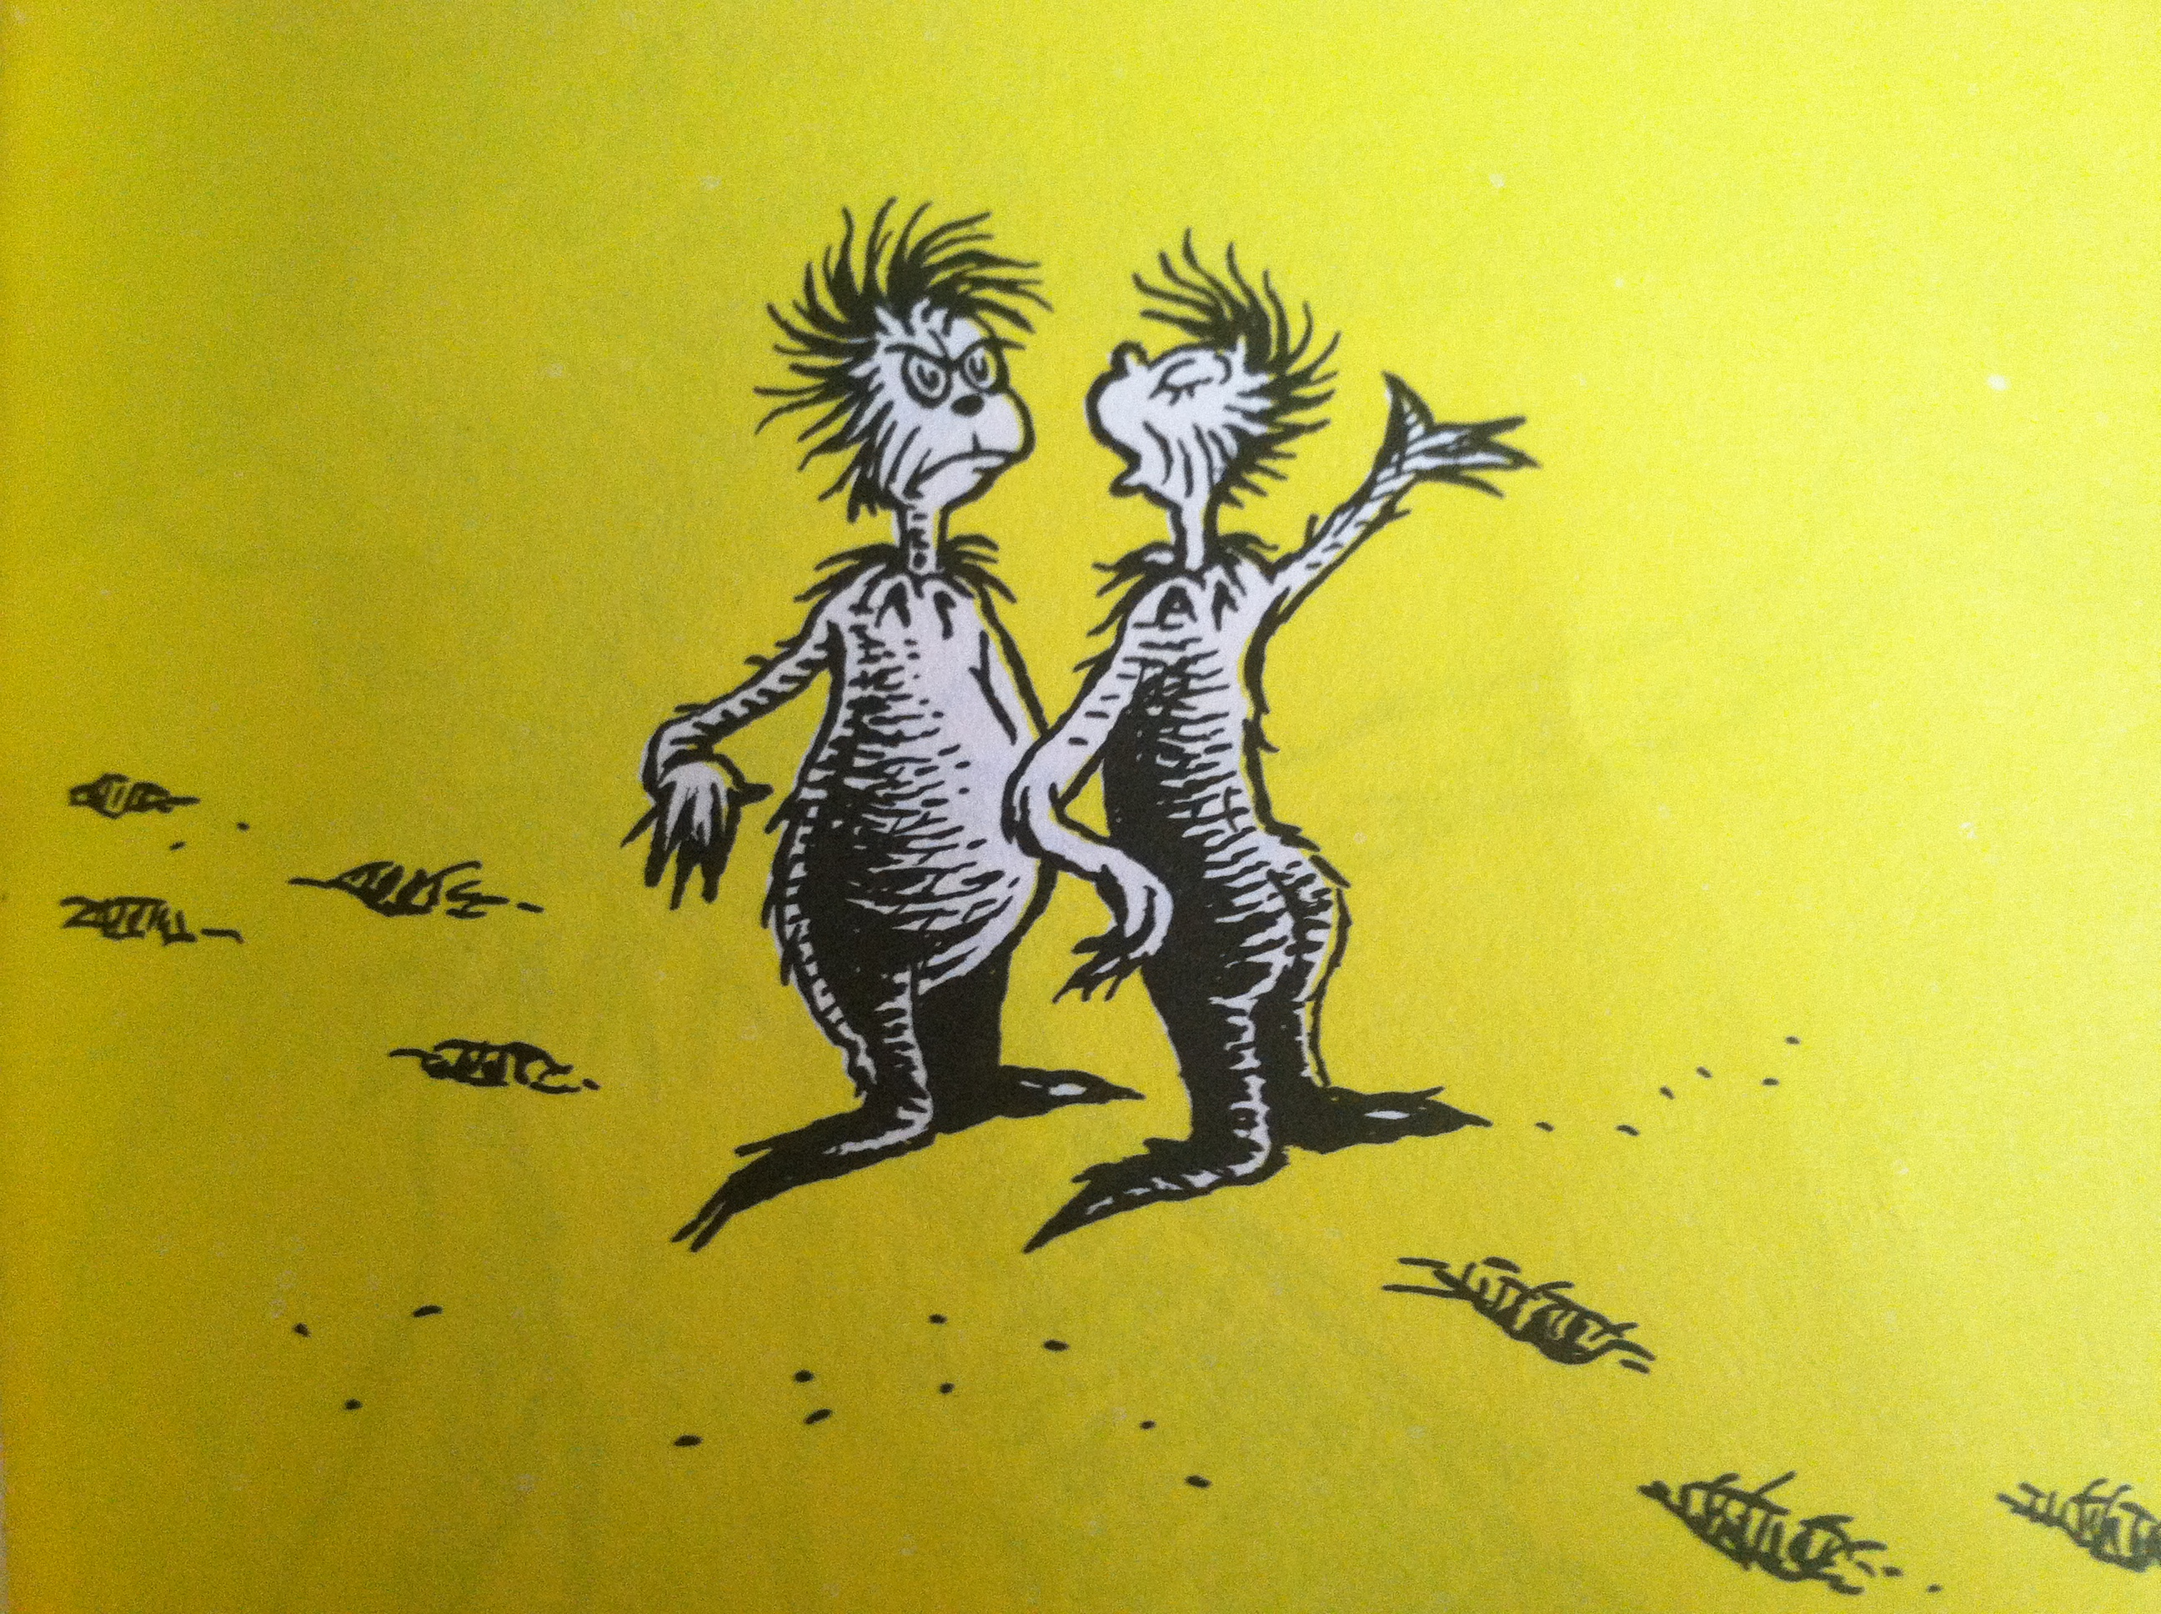
Bounded Context Relationship: Separate ways
Integrating can be difficult
High cost can cause two teams to separate
You can cancel any time and your separate way
Notes:
Not worth integrating
Cancel any time

Slide 40
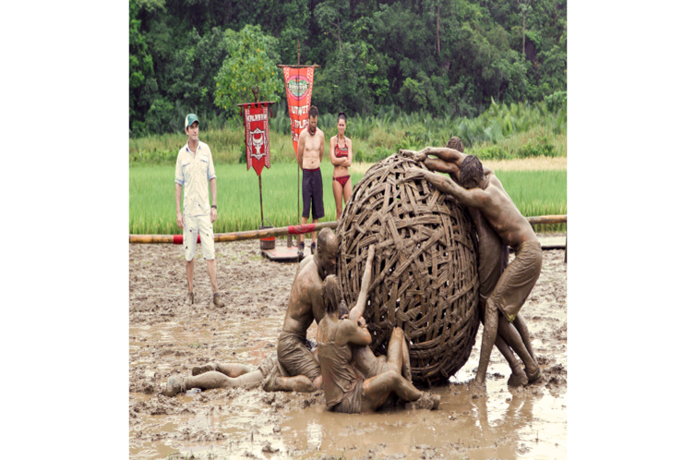
Bounded Context Relationship: Big ball of mud
Legacy system
Multiple interconnected subdomains
Use anti-corruption layer when integrating
Notes:
Legacy system is a Big Ball of Mud
Takes longer to make feature enhancements
Different parts of the application have different architectures
Certain parts are untouchable, don’t want to break it
Other times enhancements result in spooky action at a distance

Slide 41
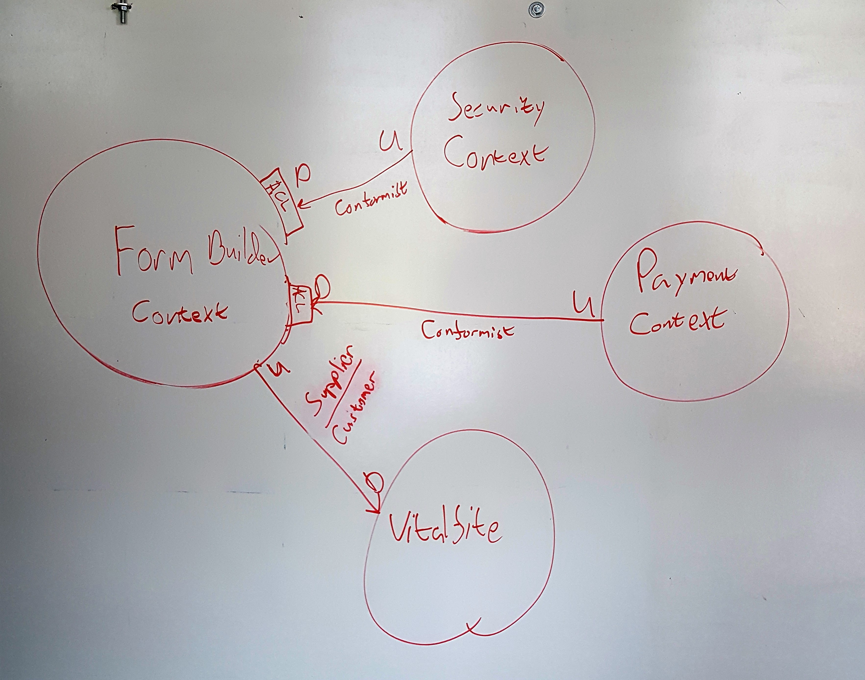
Form Builder Context Map
Notes:
Form Builder:
Four total Bounded Contexts
Describe
Legacy System
Security Context
Payments Context

Slide 42
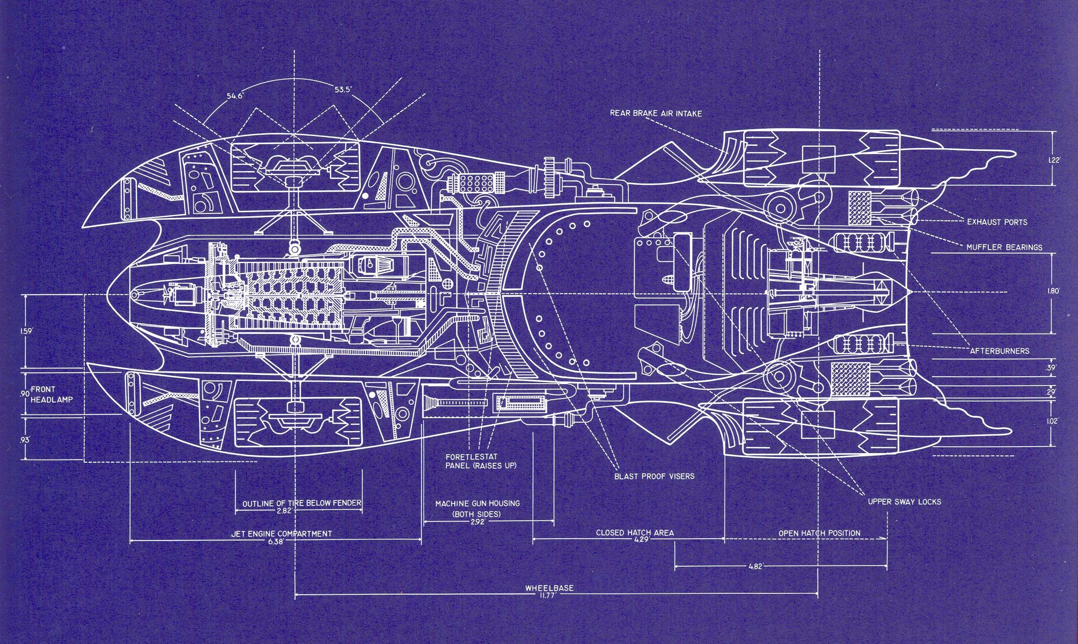
Step #4 – implementation time to code
Notes:
Context map is defined
Time to write code

Slide 43

What architecture should we use?
Pick at start of project
Should match the need of the solution
But also allow for a robust Domain Model
Acts as a blueprint
Notes:
First step pick an architecture
Form Builder architecture requirements:
Easy to understand
Easy to communicate
Easy to use

Slide 44
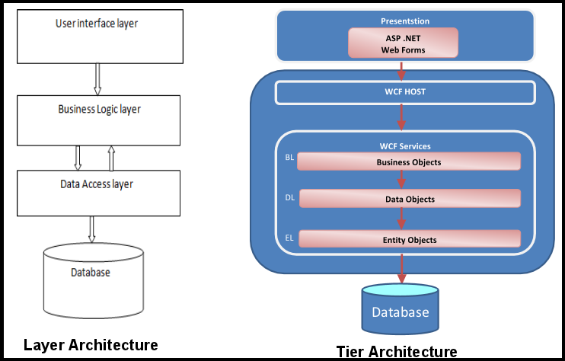
Architecture Type: N-tier or layers
Notes:
Form Builder is built using Layers Architecture
Easy to understand
Easy to implement
Will not fit all needs but Form Builder works well on it

Slide 45
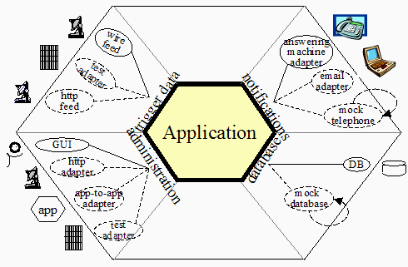
Architecture type: Hexagonal or Ports and adapters
Notes:
A lot like Layers, works well for most solutions

Slide 46
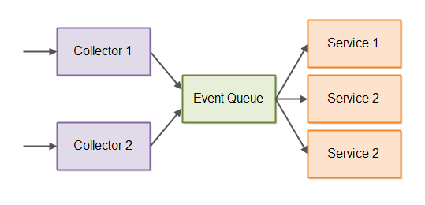
Architecture type: Event driven

Slide 47
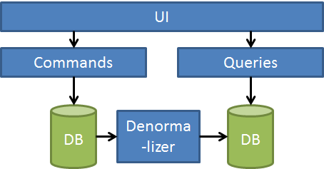
Architecture type: cqrs
Notes:
Greg Young is the expert
Built for systems with large transactions
Aggregates split into Command and Query Objects
Command Objects contain the business logic
All commands write to an Event Store
Denormalizer denormalizes event store to query database
Query Objects read in data

Slide 48
Tactical Patterns
Aggregate – Natural boundary that controls flow of information through the Aggregate Root (Entity)
Entity – Models an individual thing. Consists of a distinct identity and lifecycle
Module – Named containers for Domain Objects
Value Object – Models a value and is immutable.
Domain Service – Stateless service that captures business logic that doesn’t fit into one Entity
Repository – Collection based persistence store
Factory – Builds complex aggregates outside of the aggregate constructor
Domain Event – Value object that captures information about that event
Notes:
Tactical Patterns dictate the structure of individual classes. These require a talk onto itself.
A few pointers though:
Aggregates should be small
Entities can only have state changed through Command methods
Modules does not equal Bounded Context
Value Objects are very powerful and useful
Domain Services should not be used very often
Repository, only the interface will belong in the Domain, implementation goes in the infrastructure
Factory should only used with extremely expensive Aggregates

Slide 49

More on domain events
Very powerful, use often
Internal events use an event publisher
External events use a Message Bus/Store or an API
Leads to Event Driven architecture
Notes:
- Form Builder did not use them right away
PHI data first implementation
Rewired architecture
Use them more
Layers architecture became a hybrid
Jimmy Bogard - https://lostechies.com/jimmybogard/2014/05/13/a-better-domain-events-pattern/
Udi Dahan - http://udidahan.com/2009/06/14/domain-events-salvation/
Vaughn Vernon - https://github.com/VaughnVernon/IDDD_Samples

Slide 50

A quick word on frameworks
Notes:
Pollute Domain Model
Slight pollution ok
ORMs
Can pollute a model very quickly
DTOs
Use Dapper with a DTO for now
UI Logic
Keep business logic out of the UI
Smart UI anti-pattern
Presentation Objects
Rule of Thumb, I am skeptical of frameworks (not libraries)

Slide 51
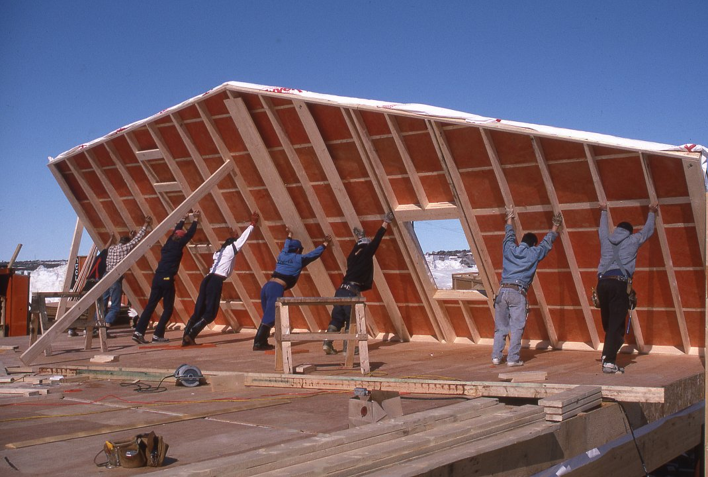
Step #5 keep solving the problem / Refactor
Notes:
As features get added:
Refactor the Domain Model
Bounded Contexts added
Big mistakes on Form Builder
Ubiquitous Language was left behind
as was interaction with Domain Experts

Slide 52
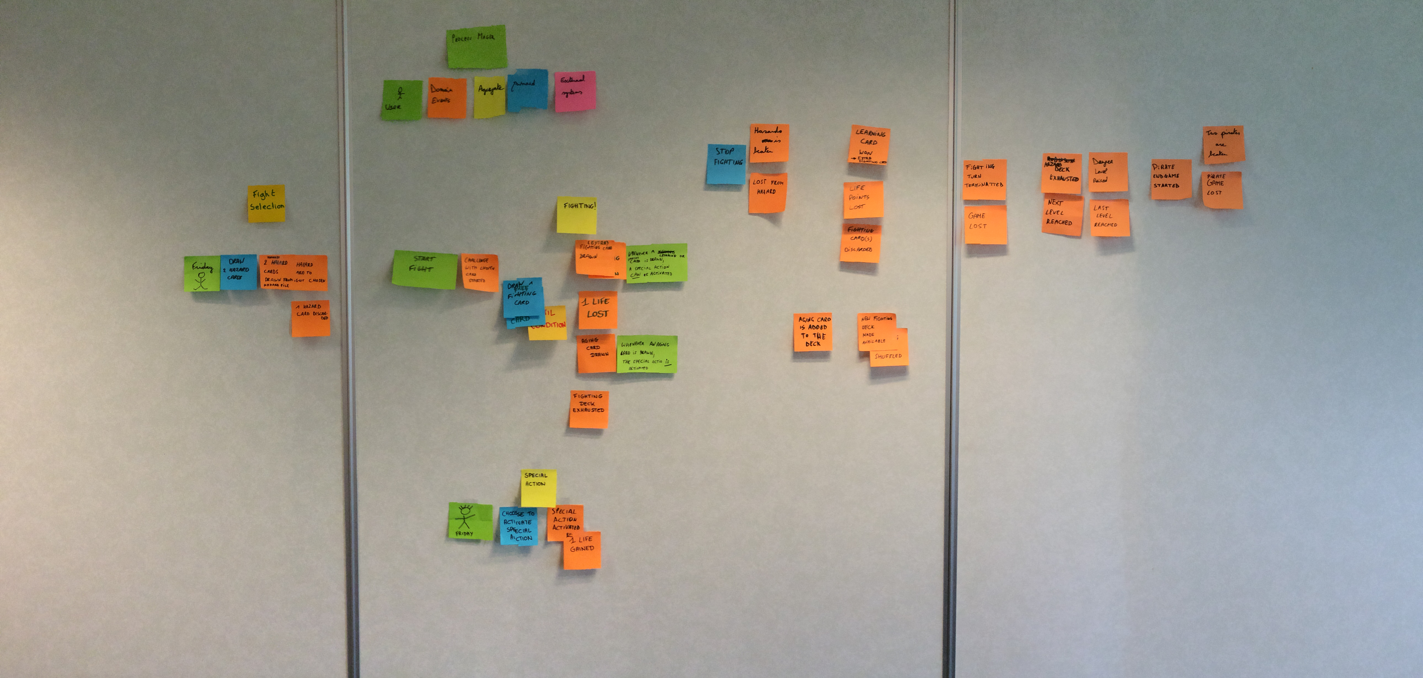
Event storming, fast tracking the learning process
Notes:
Start of project
Great way to fast track creation of Domain Model

Slide 53
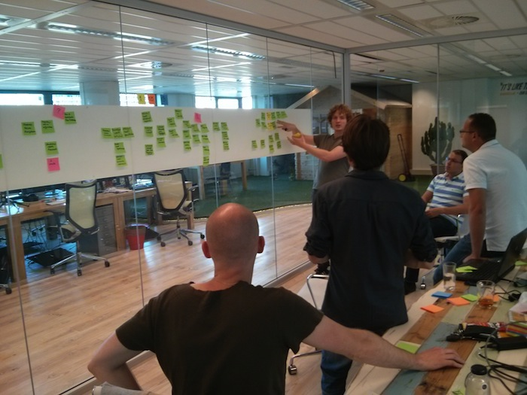
Step #0: Starting out
Notes:
Room qualities
Domain experts
Takes 2 – 4 hours
May take multiple meetings

Slide 54

Step #1: Identify Domain Events
For review, Domain Events are an important event within a bounded context
Place Domain Events in chronological order on a sticky note
Events that happen concurrently are placed within the same vertical plane
Notes:
Domain Events discussion:
Process oriented
Which keeps Domain Experts engaged

Slide 55

Step #2: identify the cause
Identify the Command that caused each Domain Event
Write the Command on a sticky note
Place directly to the left of the Domain Event
Specific Roles are written on a bright yellow sticky in the lower left corner of the command
Processes that are kicked off by Commands are written on Lilac colored sticky notes

Slide 56

Step #3: Associated Entity
Identify the associated Entity (Aggregate) to each Command/Event pair
Place it on a sticky behind the pair
Note common Entities without rearranging them

Slide 57
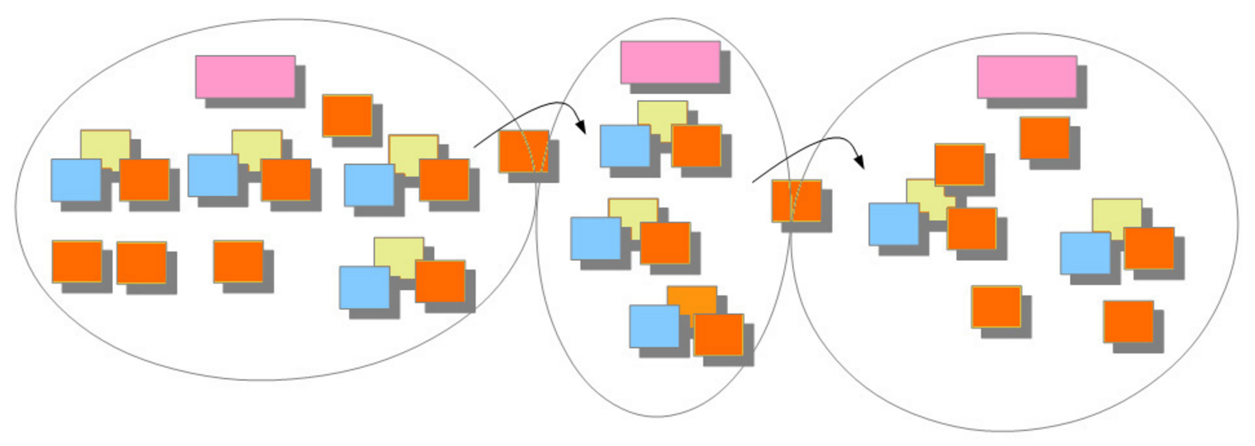
Step #4: Evaluate the model
Look for divisions in the model to identify Bounded Contexts:
Departmental divisions
Words with multiple meanings
Concepts which are important but not part of the Core Domain
Draw solid lines for Bounded Contexts and dashed Lines for subdomains
Use Pink Sticky Notes to name the Bounded Contexts
Draw arrows to show the flow of information across Contexts

Slide 58

Step #5: Identify the views
Identify any Views and put them within each Bounded Context
Role specific Views have a bright yellow sticky with the Role
If necessary, draw a quick mock up of the View

Slide 59
Event storming: summing up
Go over multiple sessions
Goal is to produce Domain Model
Up front cost that jumpstarts project

Slide 60
Lets review
Domain Driven Design solves the problems of Software Intention and Software Rot by
Keeping solutions small in size by limiting one Bounded Context per Subdomain
Focusing on language via direct communication between developers and domain experts

Slide 61
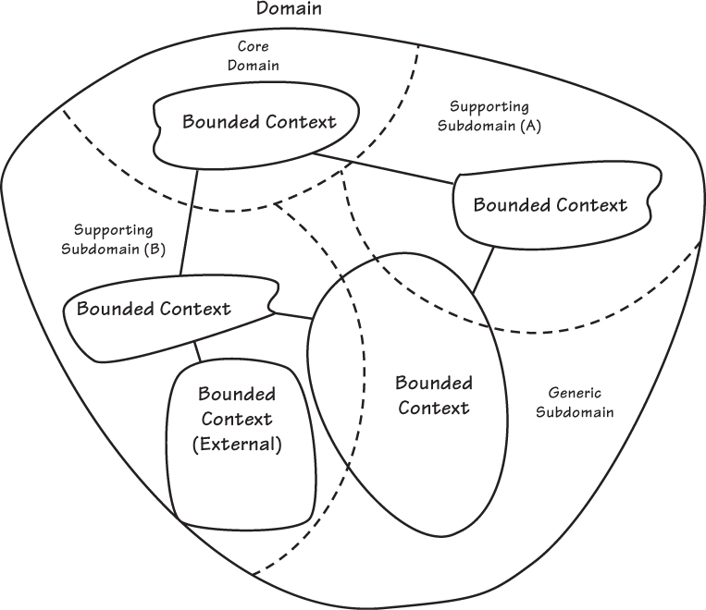
Step #1 map out the Organization with Domain Mapping

Slide 62
Step #2 solve the problem with ubiquitous language

Slide 63
Step #3 Draw out the solution space

Slide 64
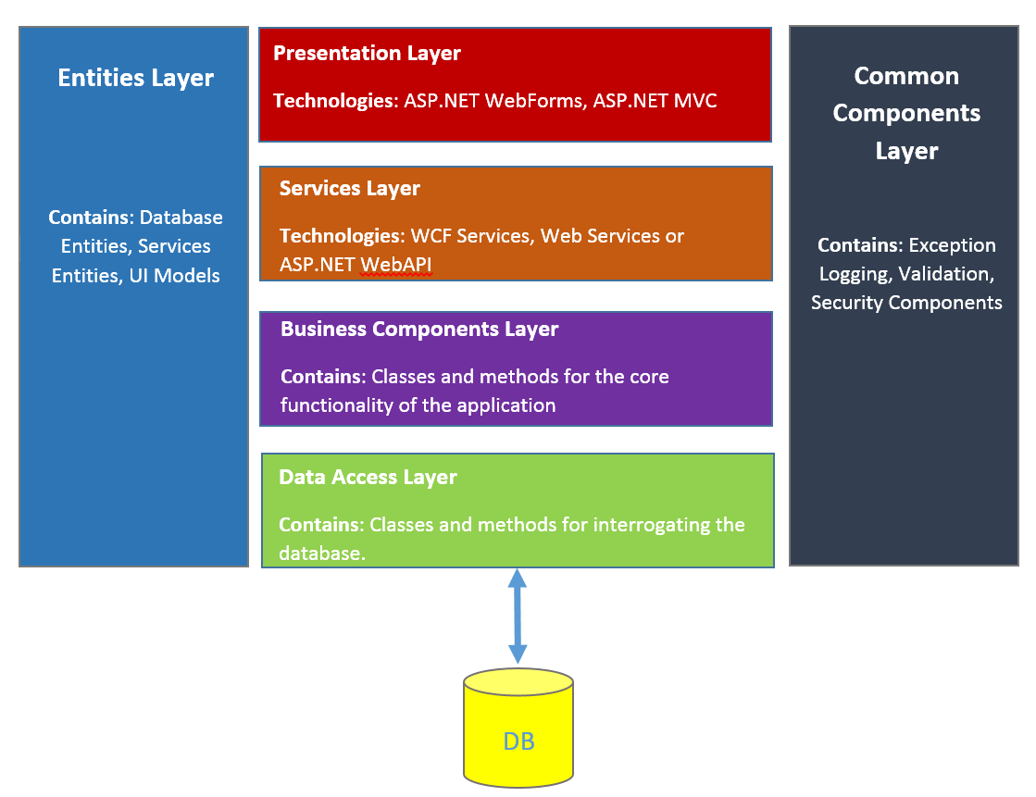
Step #4 pick an architecture and start coding

Slide 65
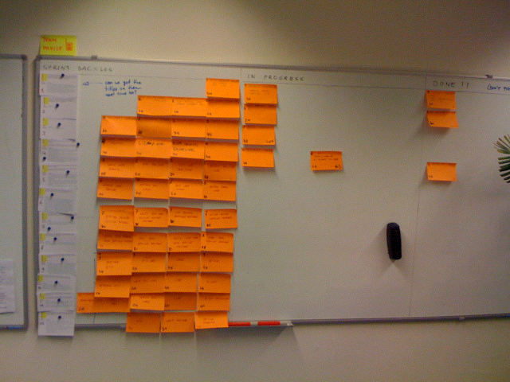
Step #5 keep flushing out the domain Model

Slide 66
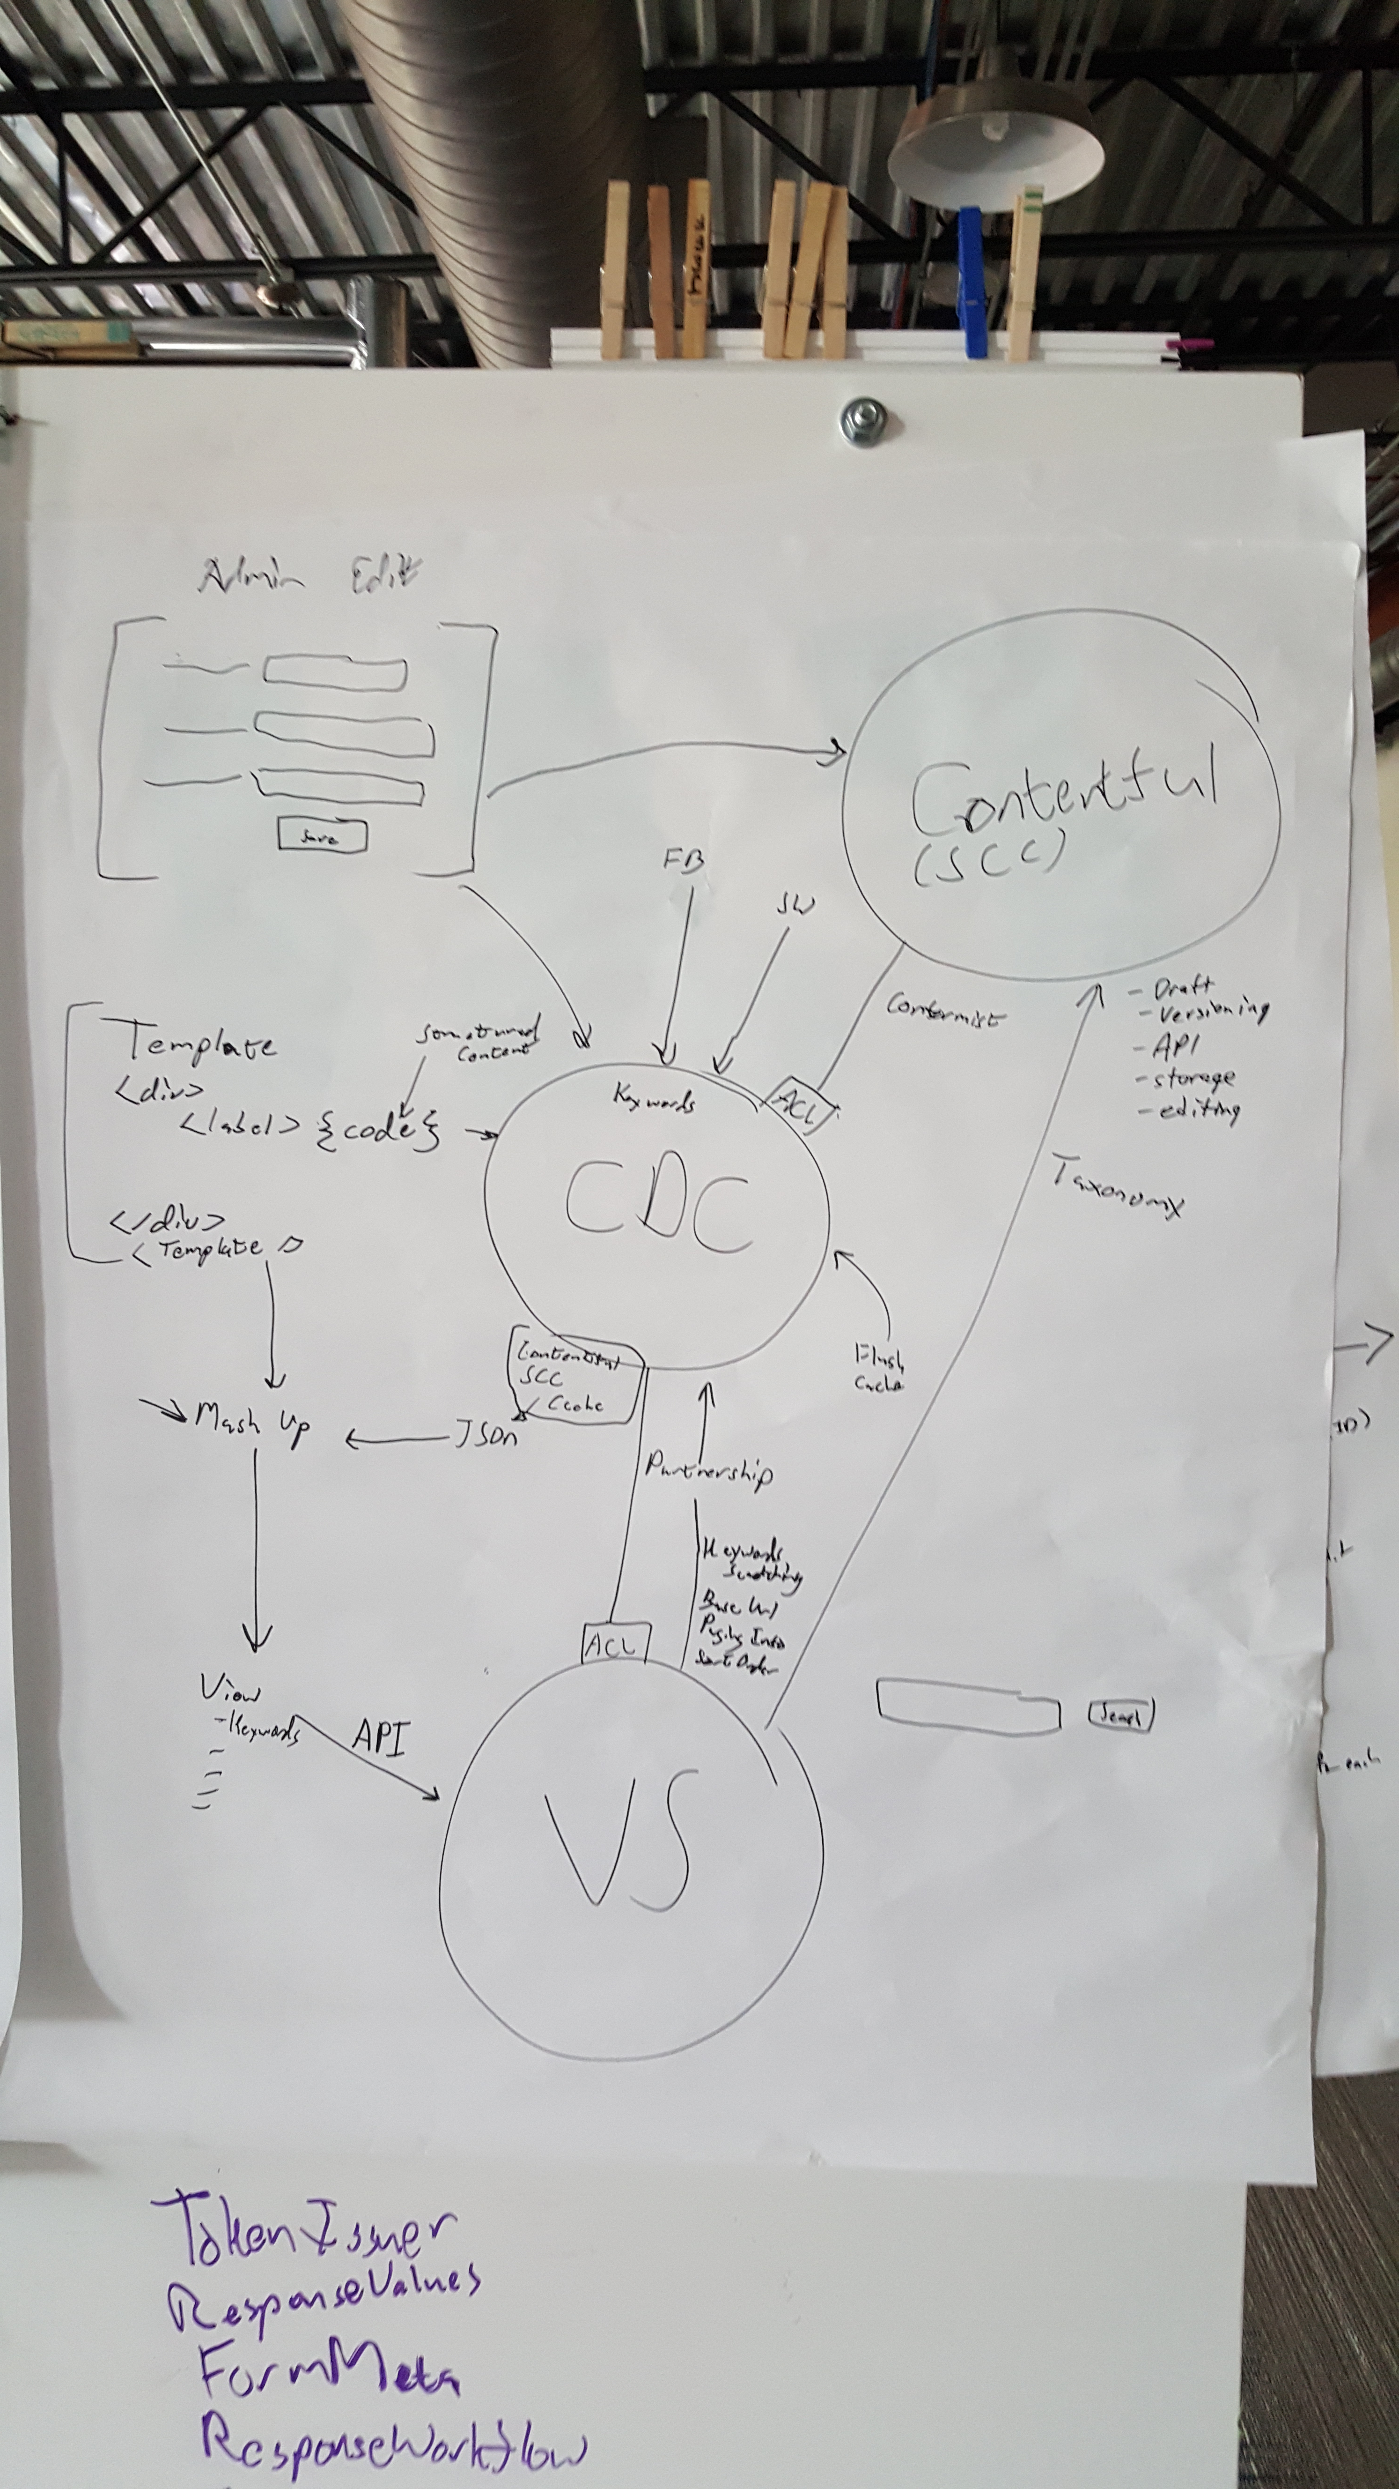
How do we do business now?
Specifically how does DDD affect how we think about the software ecosystem?
Notes:
Affects at Geo
Architecture is more modular
Apps to one thing well
Apps are now a source of truth
Domain Expert interaction, better communication flow
Describe next projects

Slide 67
More information
Interesting Books:
Domain Driven Design, Evans, 2003
Implementing Domain Driven Design, Vernon, 2013
Domain Driven Design Distilled, Vernon 2016
Interesting follows
Greg Young
Jimmy Bogard
Julie Lerman
Many others
Notes:
Describe each book
Describe each follow

Slide 68
A little about me
Twitter: https://twitter.com/rattrap79
Github: https://github.com/rattrapdev-public
Email: mateo6379@gmail.com

Slide 69
Thank you and any questions?

